Slide 1
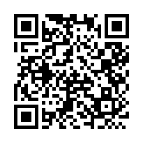
A Beta-Neutral Crypto ML Strategy: From Signal Inversion to Robust Alpha
Sam, Bill, Jannis (and HW Teng)
National Yang-Ming Chiao-Tung University
Machine Learning and FinTech
https://github.com/HWTeng-Teaching/202509-ML-FinTech
20251110 IDA Template Keynote.key

Slide 2
Motivation
Data Preprocessing
Factor Engineering & EDA
Cross-Sectional ML Prediction
Portfolio Construction
Results & Interpretation
Machine Learning & FinTech 2025

Slide 3
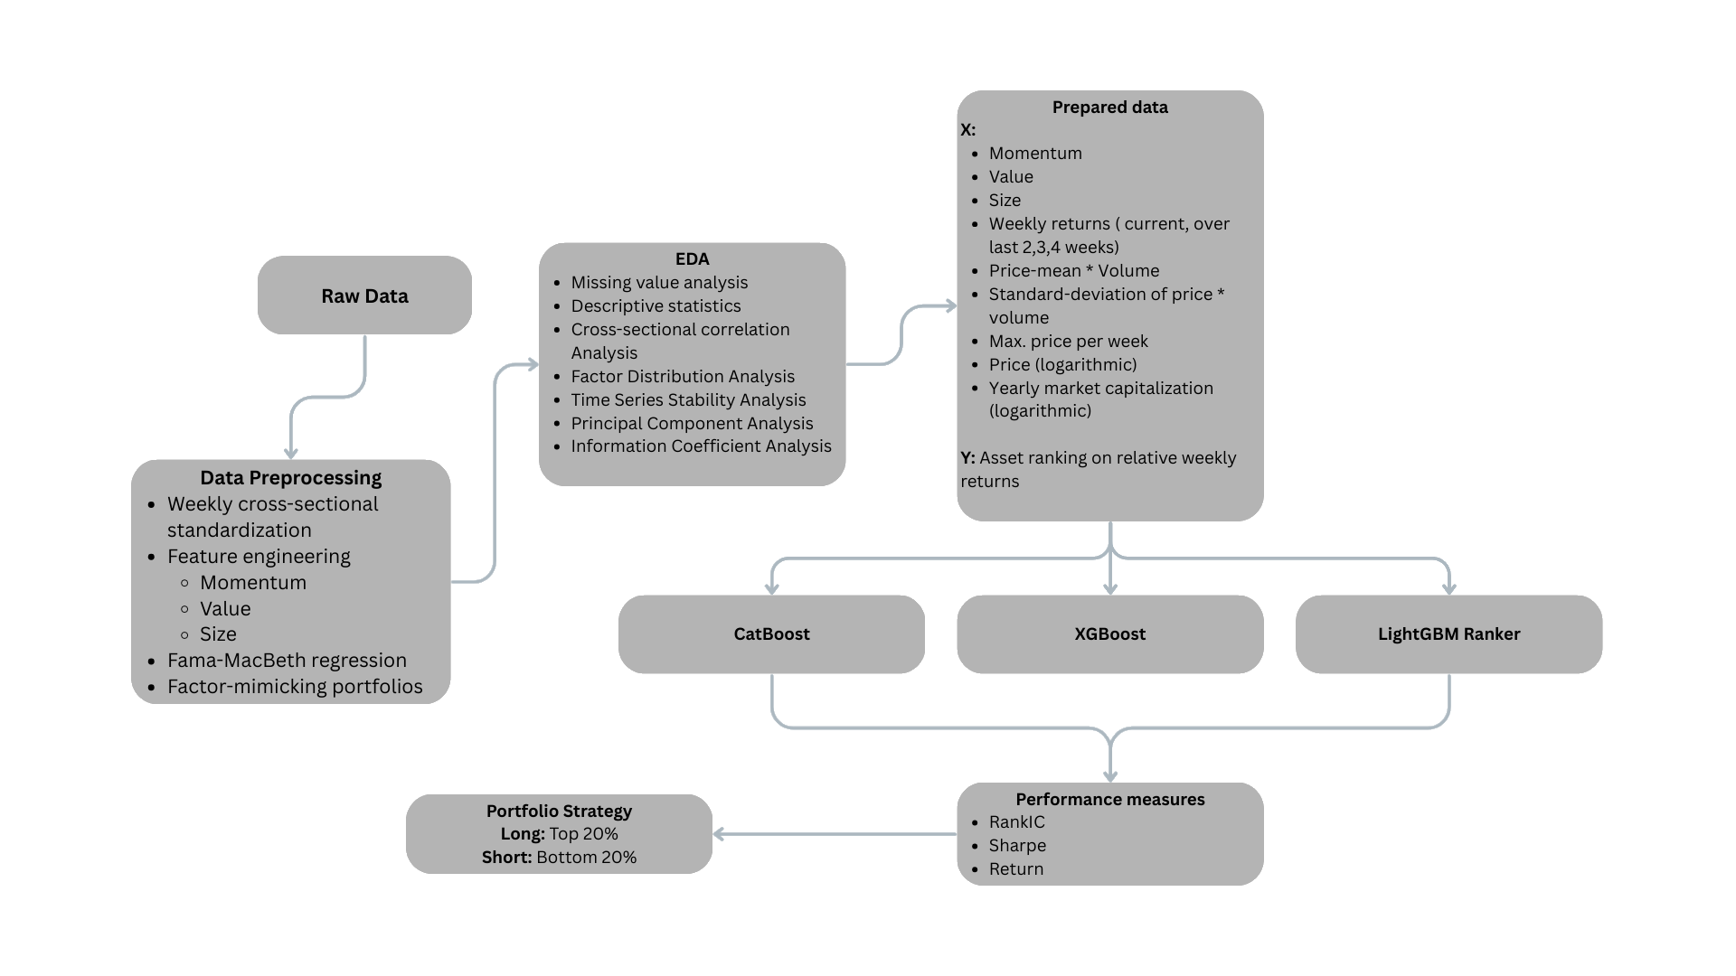
Machine Learning & FinTech 2025

Slide 4
Motivation
Motivation
Market Problem
Crypto markets exhibit extreme volatility; single assets like BTC frequently suffer -50% to -70% drawdowns.
Traditional long-only BTC or index exposure delivers high returns in bull markets but catastrophic losses in bear markets.
Institutional and professional investors need stable, risk-controlled strategies with superior risk-adjusted returns to BTC.
Machine Learning & FinTech 2025

Slide 5
Motivation
Motivation
Research Objectives
Build a beta-neutral, long–short, cross-sectional ML strategy that captures relative performance (alpha) while minimizing market-direction exposure (beta).
Control risk: reduce annual volatility and max drawdown to institutionally acceptable levels.
Improve Sharpe: target a long-run Sharpe ratio above 2.
Explain alpha sources: use feature importance and Rank IC to identify which factors drive excess returns (mean reversion, quality, liquidity, etc.).
Machine Learning & FinTech 2025

Slide 6
Section Title
Data Preprocessing
Data Sources & Universe
Weekly OHLCV prices and base factors (Binance Spot Market)
Market factor: crypto market index CMKT (Binance Spot Market)
Annual universe: selecting the top 30 large-cap / liquid assets per year.
4-week Treasury Bill rate (DTB4WK)
Build dataset with weekly frequency
Keep only the intersection of annual top 30 and complete weekly data to ensure tradability and data quality.
Machine Learning & FinTech 2025

Slide 7
Section Title
Data Preprocessing
Exploratory Data Analysis
Missing value analysis
Descriptive statistics
Cross-sectional correlation Analysis
Factor Distribution Analysis
Time Series Stability Analysis
Principal Component Analysis
Information Coefficient Analysis
Machine Learning & FinTech 2025

Slide 8
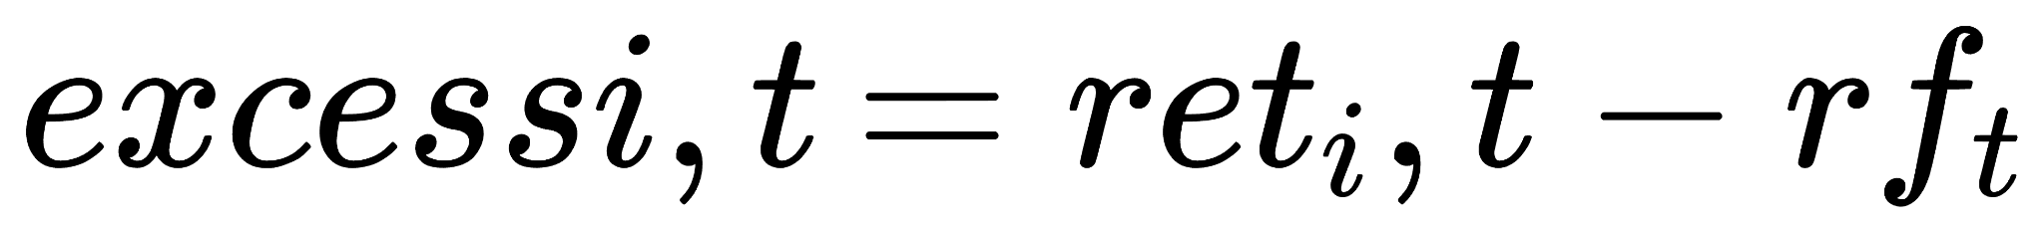
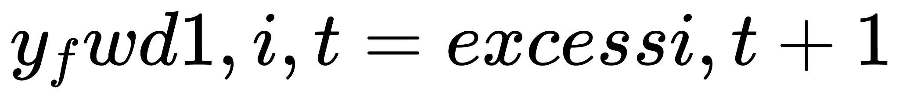
Section Title
Data Preprocessing
Returns & Volatility Definitions
Weekly excess return:
Next-week excess return (base prediction target):
Risk factors: 4-week and 12-week historical volatility (rolling std of weekly returns).
Machine Learning & FinTech 2025

Slide 9
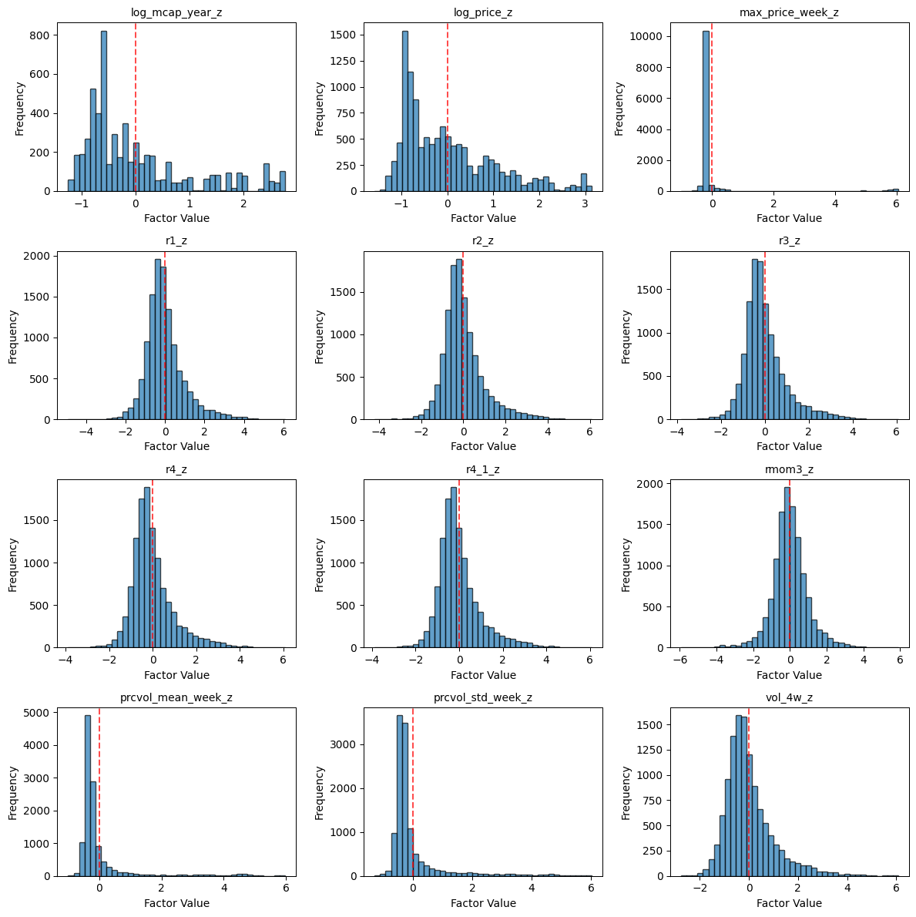
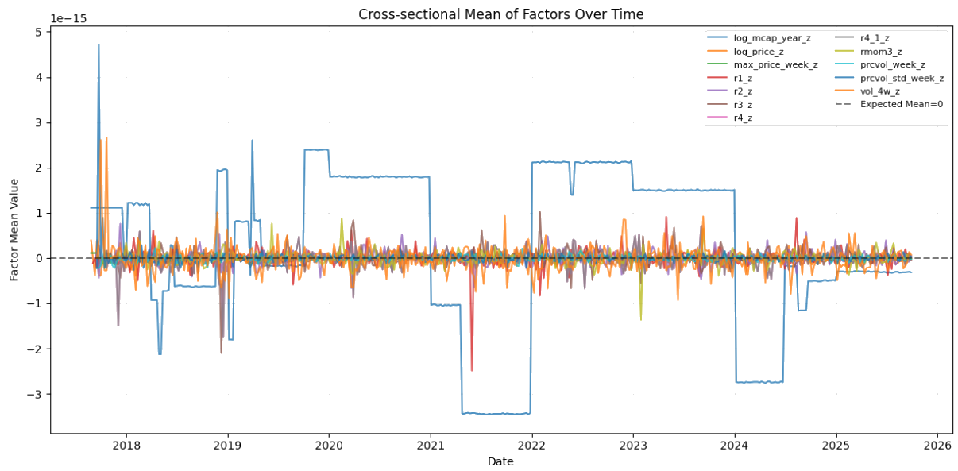
Section Title
Data Analysis
Machine Learning & FinTech 2025

Slide 10
Section Title
Feature Engineering & EDA
Technical & Risk Features
We extract from weekly OHLCV :
RSI (14): overbought / oversold conditions.
ATR (14) / Price: relative volatility.
Bollinger Band Width (20): range-based volatility.
MACD Histogram: trend momentum shifts.
Price / MA(20, 50): deviation from moving averages.
Rolling Volatility (4w, 12w): short- and medium-term risk.
All features are cross-sectionally z-scored per week, focusing on relative levels within each week and enabling cross-sectional ranking.
Machine Learning & FinTech 2025

Slide 11
Section Title
Feature Engineering & EDA
Feature Importance
Top-20 LightGBM Gain features are dominated by:
Short-/medium-term returns: r1_z, r2_z, r3_z, r4_z, mom3_z.
Technical indicators: Close_div_MA20_z, RSI_14_z, Close_div_MA50_z, MACD_z.
Volatility & ranges: Vol_12w_z, Vol_4w_z, ATR_14_norm_z, BB_Width_20_z.
Liquidity/volume: prcvol_mean_week_z, prcvol_std_week_z.
Conclusion: the model heavily relies on “short-term momentum + technical + volatility/volume” signals, while size/price play a supporting backbone role.
Machine Learning & FinTech 2025

Slide 12
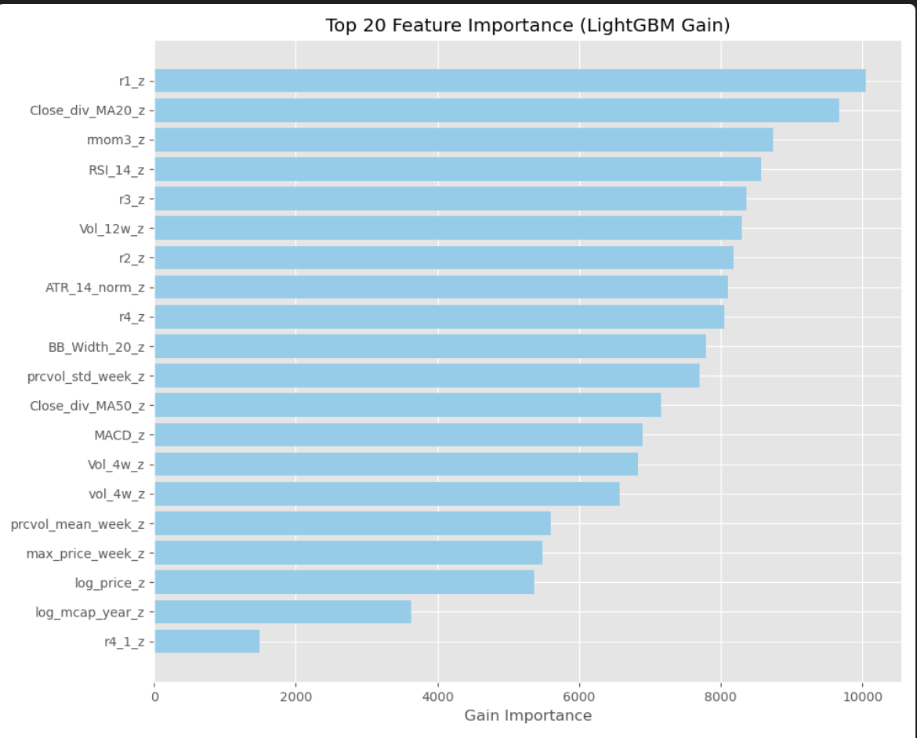
Section Title
Feature Engineering & EDA
Feature Importance
Machine Learning & FinTech 2025

Slide 13
Section Title
Feature Engineering & EDA
Rank IC Evidence
Factors with positive Mean Rank IC:
log_mcap_year_z, log_price_z, max_price_week_z, prcvol_mean_week_z, prcvol_std_week_z.
⇒ Large-cap, higher-priced and more liquid/active assets tend to have better risk-adjusted returns (quality / liquidity tilt).
Factors with negative Mean Rank IC:
Vol_4w_z, Vol_12w_z, ATR_14_norm_z, BB_Width_20_z.
⇒ High-volatility, high-ATR assets typically underperform, making them good short or de-weighting candidates.
Cumulative Rank IC shows that size/liquidity factors accumulate IC over time, indicating persistent structural alpha rather than one-off episodes
Machine Learning & FinTech 2025

Slide 14
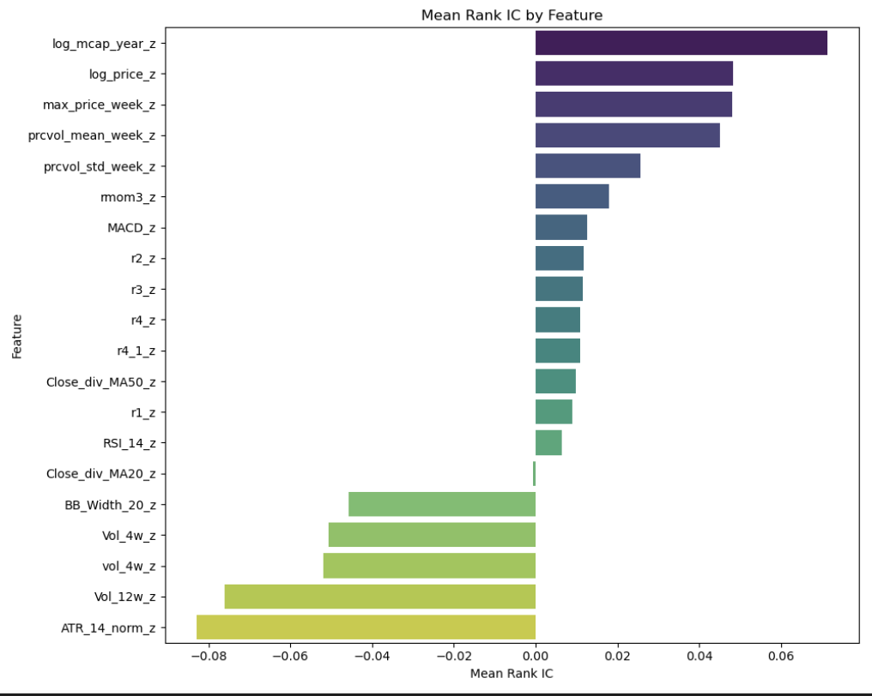
Section Title
Feature Engineering & EDA
Rank IC Evidence
Machine Learning & FinTech 2025

Slide 15
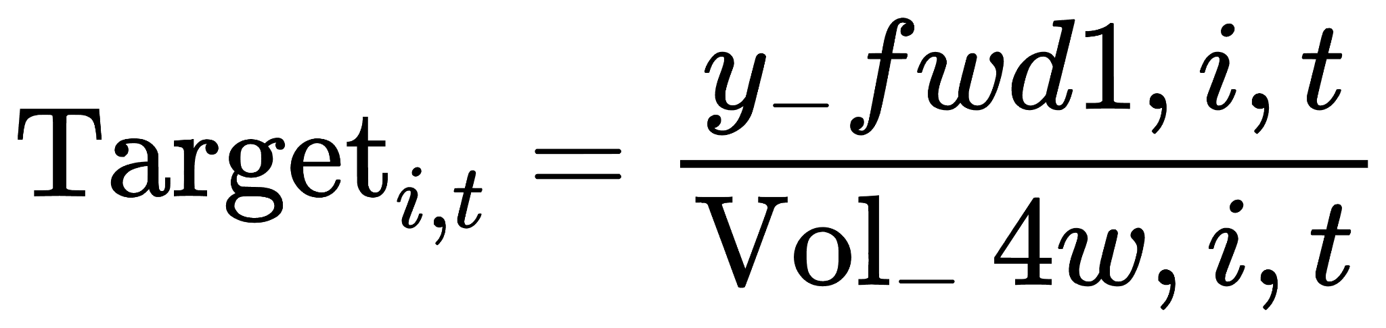
Section Title
Cross-Sectional ML Prediction
Volatility-Scaled Target
Prediction target:
Prevent the model from simply chasing high-volatility, high-return small tokens.
Force the model to learn risk-adjusted excess returns, improving robustness.
Machine Learning & FinTech 2025

Slide 16
Section Title
Cross-Sectional ML Prediction
DART Boosting / Model Architecture & DART
Main model: LightGBM LambdaRank (cross-sectional ranking)
DART = Dropouts meet Additive Regression Trees.
Randomly drops part of the existing trees before fitting a new one
Benefits: reduces overfitting and improves generalization, especially on noisy financial data.
Auxiliary model: Ridge Regression
Provides a linear, smooth baseline and mitigates extreme nonlinear biases.
Ensemble: 0.6 LGB + 0.4 Ridge
Machine Learning & FinTech 2025

Slide 17
Section Title
Cross-Sectional ML Prediction
Rolling Walk-Forward Setup
Use at least 52 weeks of history as the initial training set; the most recent 8 weeks are used for validation.
Refit the model every 4 weeks, processing a total of 373 weeks of data.
Each week is treated as a ranking group; the model learns which assets should rank higher or lower within the same week.
Machine Learning & FinTech 2025

Slide 18
Section Title
Portfolio Construction
Bucketing & Signal Inversion
Each week, ensemble scores are bucketed into 5 quantiles (Q=5).
raw scores are negatively correlated with future returns.
Long: bottom 20% (lowest-score quantile).
Short: top 20% (highest-score quantile).
Interpretation: the model effectively detects over-extended assets; high scores indicate short-term overheating and likely mean reversion, while low scores correspond to overlooked but higher-quality names.
Machine Learning & FinTech 2025

Slide 19
Section Title
Portfolio Construction
Risk Constraints
Total gross leverage: GROSS_LEV = 1.0 (|long| + |short| = 100%).
Per-asset weight cap: |w_i| ≤ 10%.
Weekly per-asset turnover cap: |Δw_i| ≤ 30%.
One-way transaction cost: 10 bps.
Goal: control concentration and trading frictions, making the strategy implementable in practice.
Machine Learning & FinTech 2025

Slide 20
Section Title
Portfolio Construction
Beta Neutrality & Vol Targeting
Estimate each asset’s beta via a 52-week rolling regression on CMKT.
Adjust portfolio weights by
to achieve near beta neutrality.
Using 26-week historical volatility, scale exposure to keep annualized volatility around 30%:
De-leverage in high-vol regimes, scale up in low-vol regimes.
Result: a stable and more investable risk profile.
Machine Learning & FinTech 2025

Slide 21
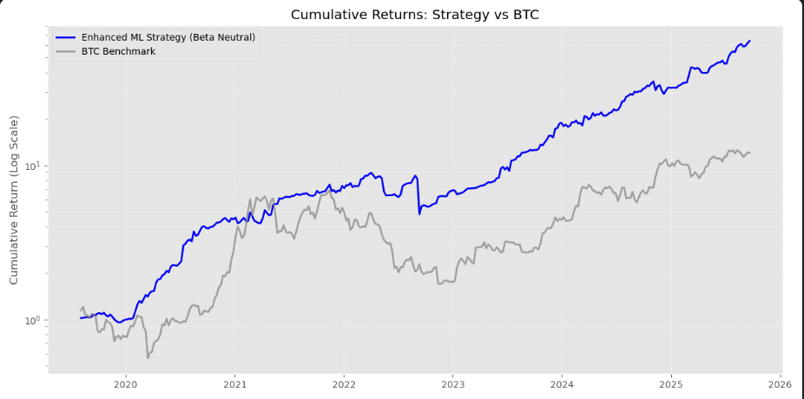
Section Title
Results & Interpretation
Cumulative returns (log scale)
The beta-neutral strategy (blue) shows a smooth, steadily rising curve, clearly outperforming BTC (gray) over the full sample.
Log scale allows fair comparison across different compounding phases.
Machine Learning & FinTech 2025

Slide 22
Section Title
Results & Interpretation
ML Strategy VS BTC Benchmark
 | Benchmark | Strategy
Annual Return | 3831% | 75%
Annual Volatility | 9577% | 37%
Sharpe Ratio | 0.4 | 2.03
Max Drawdown | -70.1% | -46.1%
Avg Turnover | 0.72 | 0.72
Machine Learning & FinTech 2025

Slide 23
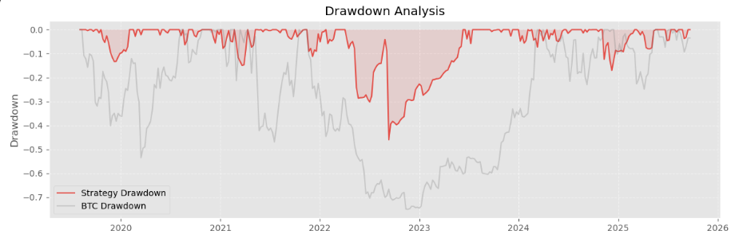
Section Title
Results & Interpretation
Drawdown
Strategy max drawdown is around -20% to -25%, with most periods within -10%.
BTC experiences multiple drawdowns beyond -50%, approaching -70%.
Machine Learning & FinTech 2025

Slide 24
Section Title
Results & Interpretation
Feature Importance & Signal Inversion
LightGBM primarily relies on momentum + technical + volatility features:
High-scoring assets are typically “recent high flyers with elevated volatility and overheated technicals.”
Mean Rank IC shows volatility and ATR-type features carry negative signals:
The more volatile the asset, the worse it tends to perform next week.
⇒ Over-extended assets likely to underperform,
Inverting the signal (long low scores, short high scores) with a mean-reversion strategy.
Machine Learning & FinTech 2025

Slide 25
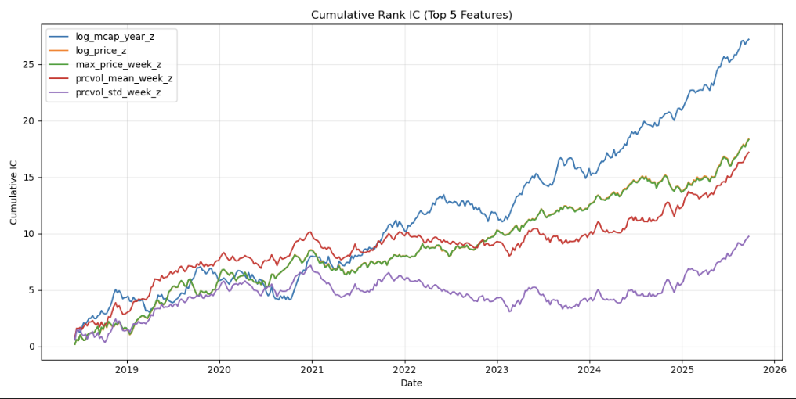
Section Title
Results & Interpretation
Cumulative Rank IC
Machine Learning & FinTech 2025

Slide 26
Section Title
Results & Interpretation
Cumulative Rank IC
Large-cap, liquid, high-attention assets consistently outperform on a risk-adjusted basis, creating a structural quality/liquidity alpha.
The strategy effectively combines two core components:
A quality/liquidity tilt toward large, liquid names.
A mean-reversion short/underweight leg against short-term over-extended, high-volatility names.
Machine Learning & FinTech 2025

Slide 27
Section Title
Results & Interpretation
Conclusion
Starting from the motivation: in a noisy, highly volatile crypto market, we aim for a risk-controlled, beta-neutral alpha strategy.
Through data filtering and feature engineering, we focus on the annual top-30 large-cap universe and build momentum, technical, volatility, liquidity, and size factors.
Using a volatility-scaled target with DART-LightGBM and Ridge ensemble, we learn which assets will outperform on a risk-adjusted basis in the next week.
Empirically, model scores detect “over-extended vs stable high-quality” assets, which naturally leads to signal inversion plus long–short, beta neutrality, and volatility targeting.
Final outcome:
Cumulative returns consistently outperform BTC;
Annual volatility and max drawdown are greatly reduced;
Sharpe ≈ 2 with a clear, interpretable strategy (mean reversion + quality/liquidity).
Machine Learning & FinTech 2025

Slide 28
A Beta-Neutral Crypto ML Strategy: From Signal Inversion to Robust Alpha
Sam, Bill, Jannis (and HWTeng)
National Yang-Ming Chiao-Tung University
Machine Learning and FinTech
https://github.com/HWTeng-Teaching/202509-ML-FinTech
20251110 IDA Template Keynote.key

